Slide 1
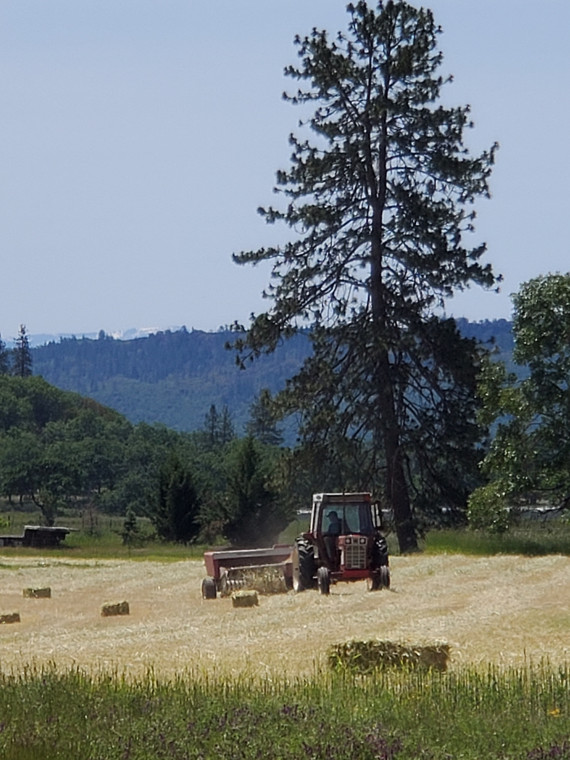
Hay Production

Slide 2
Basic Steps
Plant
Prepare soil
Fertilize
Driil seed
Irrigate vs. Dry Farm
Mow
Tedder and Rake
Bale
Stack & Store
Bale wagon
Bucking
Market and Sell

Slide 3
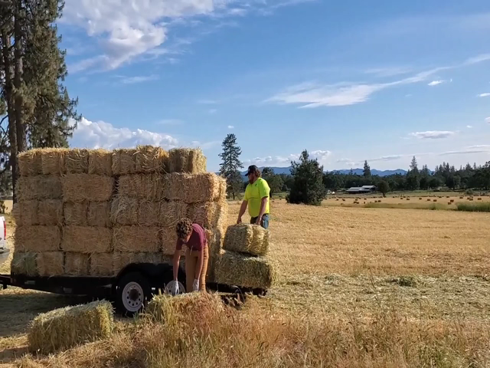
Bucking Hay
Not long ago, it was common for teenagers and young adults to get summer jobs bucking hay. Paid by the bale. The faster you stacked, the more money you made. Today, “bucking” hay is a skill slowly being lost.

Slide 4
Types of Hay
Name | Type
Alfalfa | Legume
Barley | Cereal Grain
Clover | Legume
Orchard Grass | Grass
Teff | Grass
Timothy | Grass
Triticale | Cereal Grain

Slide 5


Summary
Plant, grow, bale and store your hay
Know the pros and cons of different hay types
Market your hay

Slide 6
Year | Revenue
2019 | 260
2020 | 543
2021 | 245
2022 | 433

